Slide 1
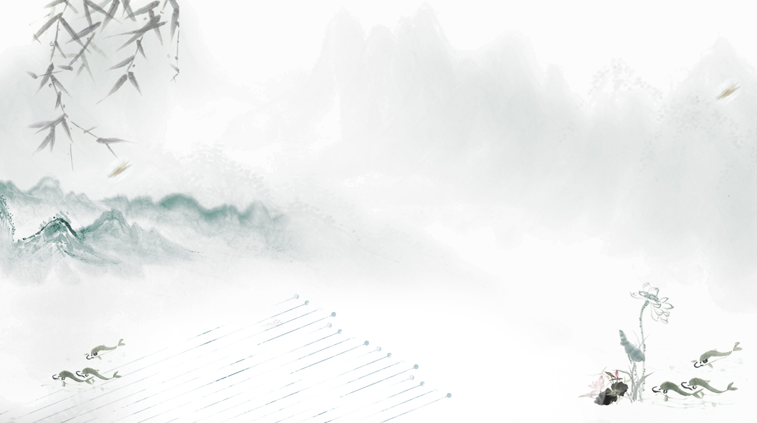

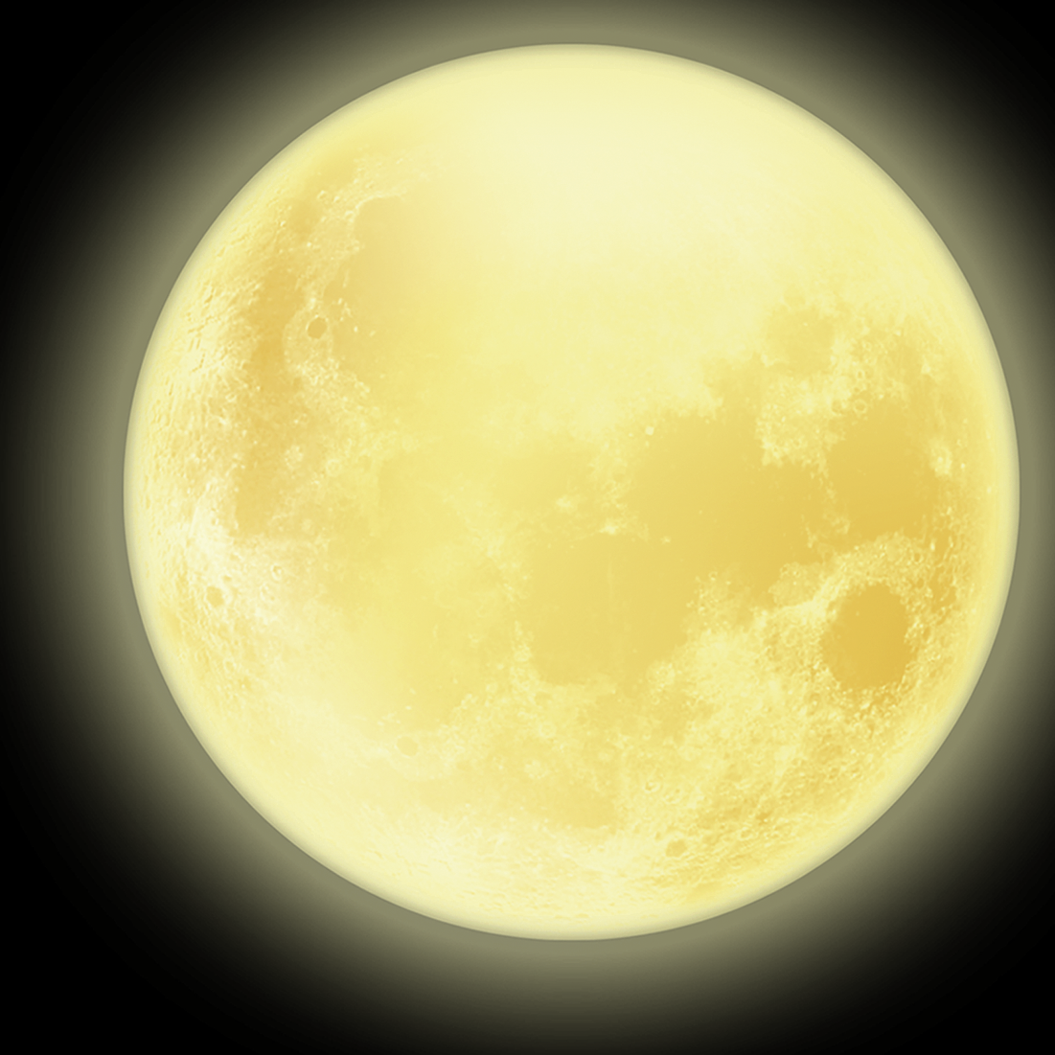
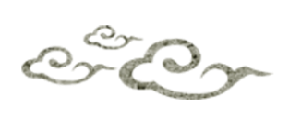
Mooncake
月饼

Slide 2
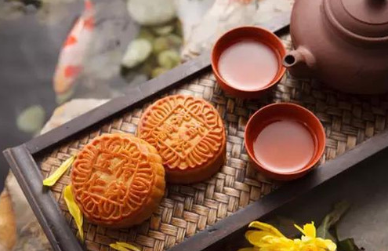
Mooncake Usage and History
Mooncakes are offered between friends or on family gatherings while celebrating the festival.
And the Autumn festival is one of the our most important Chinese festivals.
Legend has it that during the Yuan Dynasty mooncakes were used by the Chinese to plan a rebellion against the Mongol government. It is said that they conveniently used the Mid-Autumn Festival timing to seek permission to distribute mooncakes, which (conveniently) the Mongols did not eat.

Slide 3
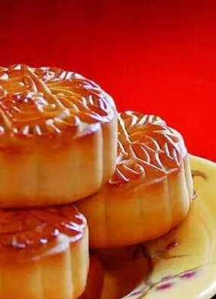
I eat it only on Mid-Autumn Festival
It is easy to find the ingredients, mainly consisting of a thick, tender pastry skin enveloping a sweet, dense filling, and may contain one or more whole salted egg yolks in their center as the symbol of the full moon. Very rarely, mooncakes are also served steamed or fried.

Slide 4

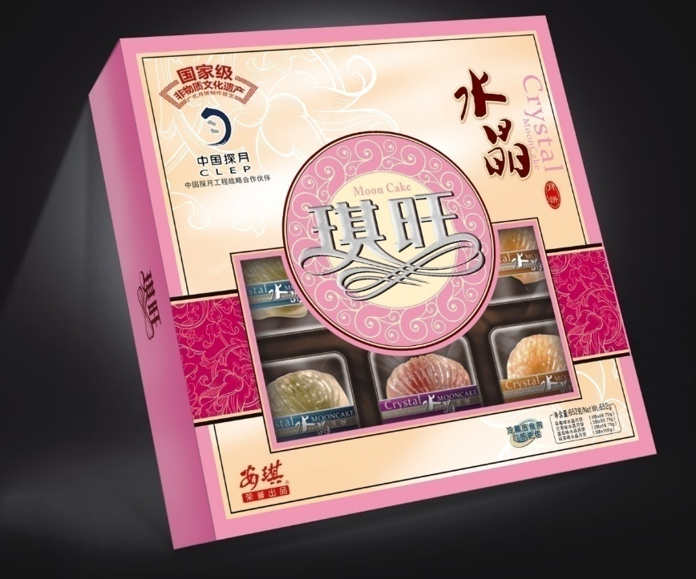
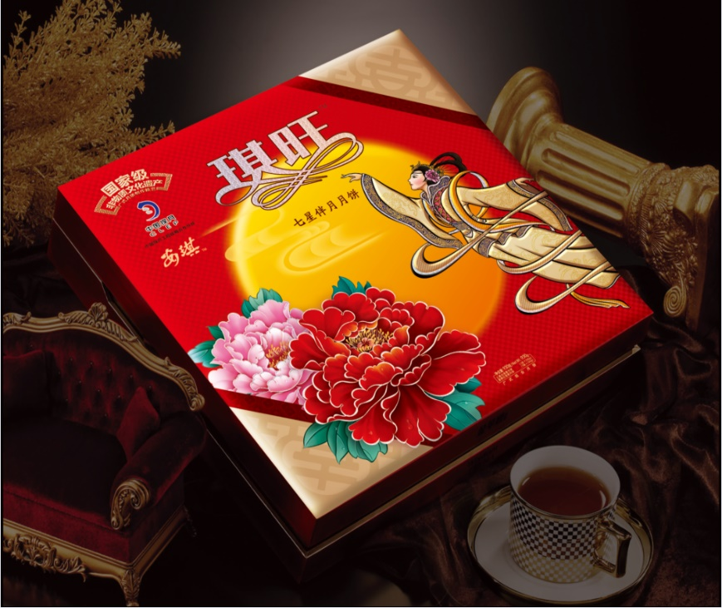
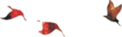
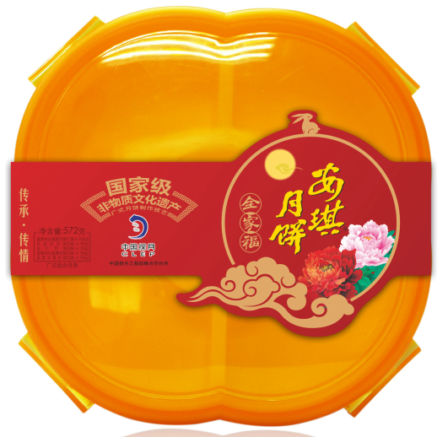
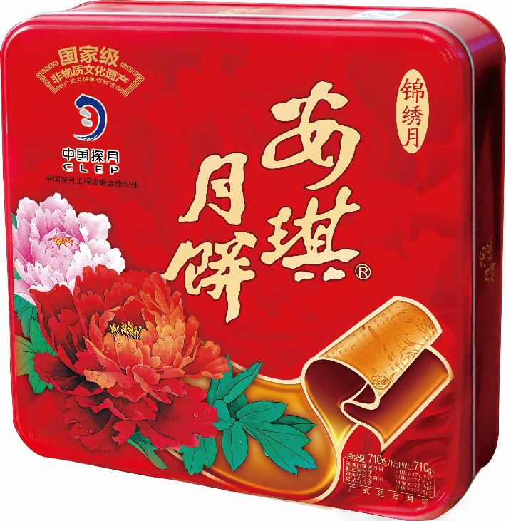
gift
中
秋
快
乐

Slide 5
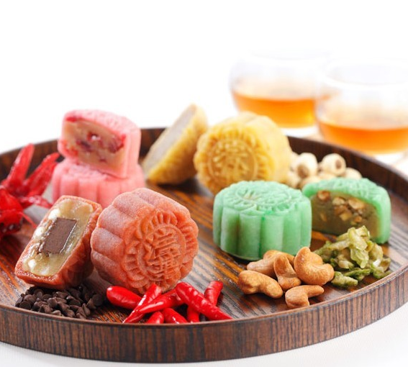
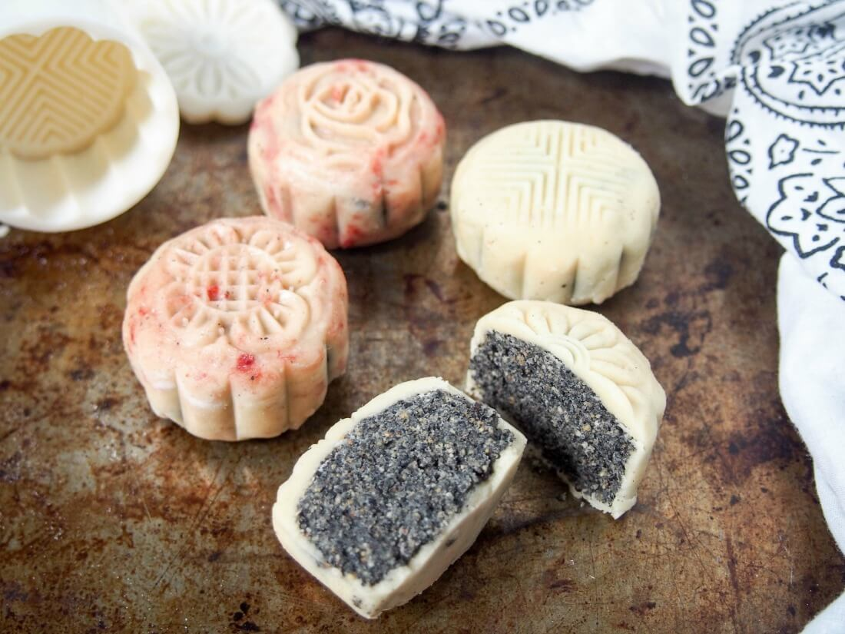
Other types

Slide 6
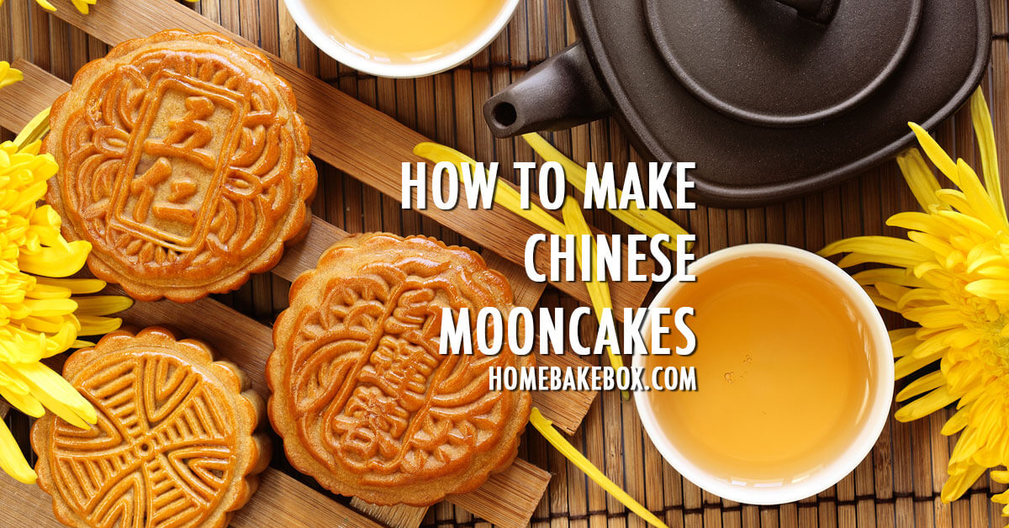
中
秋
快
乐

Slide 7
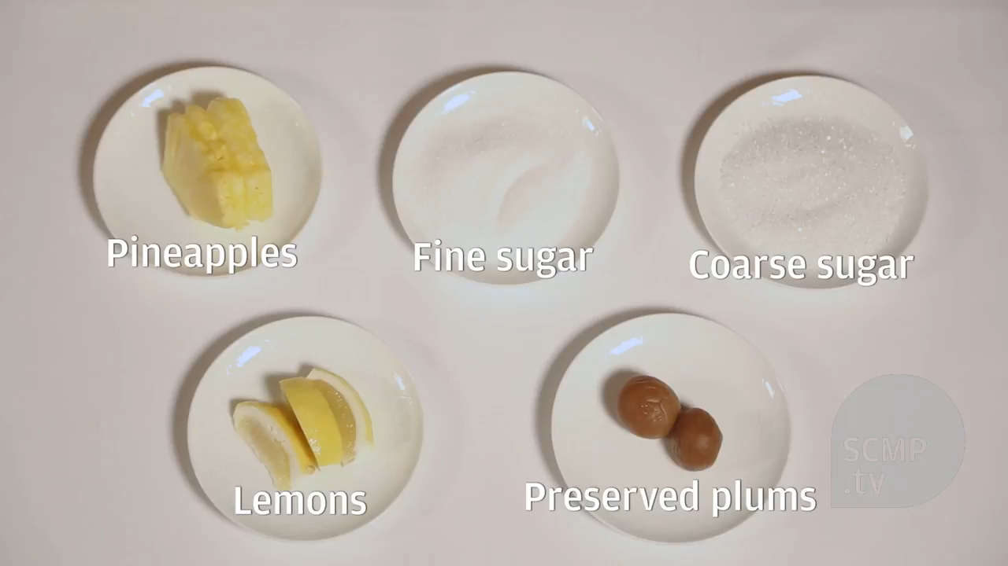
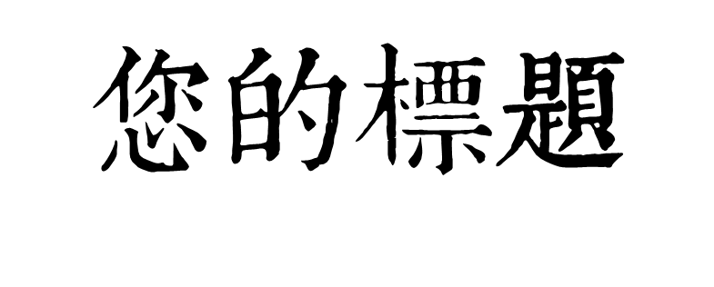
您的标题
中
秋
快
乐

Slide 8
月饼
中
秋
快
乐
Yue Bing

Slide 9
Thanks for listening!
月饼

